Slide 1
Final Engagement Session

Slide 2
Today’s Objectives
Individual and collective reflection on our experiences
2. Identify next steps

Slide 3
Today’s Agenda
1
2
3
4
5
6
Check-in
9:25-9:35
Reflection Activity or
Interviews
9:35-10:05
Brain Break
10:05-10:10
Netter Team
10:10-10:15
Reflection Activity or
Interviews
10:15-10:40
Check Out
10:40-10:55

Slide 4
1
Check-in
Complete post-project survey
Fill out email sign up sheet if you’d like to stay in touch about the paper

Slide 5
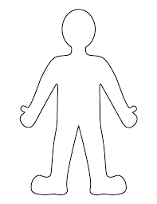
2
Drawing Reflection
How was this experience affected you?
Head - what did you learn?
Heart - how do you feel?
Hands - what do you have to give?
Feet - what are your next steps?
Outside oneself - how does this connect to your community?

Slide 6
Brain Break

Slide 7
Netter Summer Programs

Slide 8

4
Flip Chart Reflection
Questions:
How do you want to carry this work forward? As a class? Over the summer & beyond?
Netter programs recommendations
What do you like or want to see more of?
What don’t you like or want to see less of?
Ideas for getting students involved?

Slide 9

Check out
What’s one thing that gives you hope?

Slide 10
Thank you for an incredible semester!

